Slide 1
Tampa Deep-Sea X-plorers
AUV Entry
For
OPENWERX
Competition

Slide 2
About Us
Tampa Deep-Sea X-plorers is an LLC in Florida formed for the purpose of competing in the
Shell Ocean Discovery XPRIZE

Slide 3
The Challenge
Build a small underwater robot that looks like a marine organism.
The robot should, to the degree feasible, use a natural looking propulsion mechanism.
The robot should be able to travel 200 meters without a recharge.

Slide 4
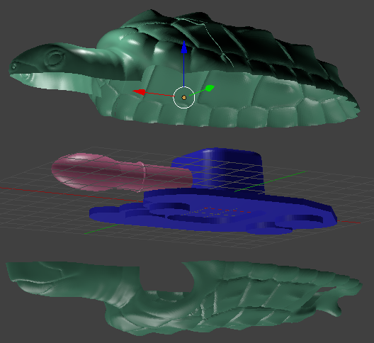
Our Solution
The Turtle AUV!

Slide 5
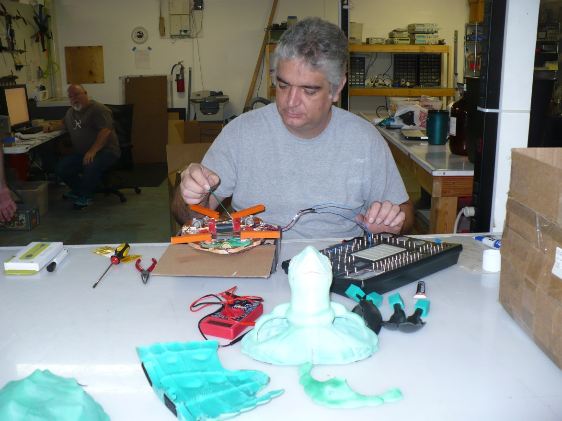
Our Solution
The Turtle AUV!

Slide 6
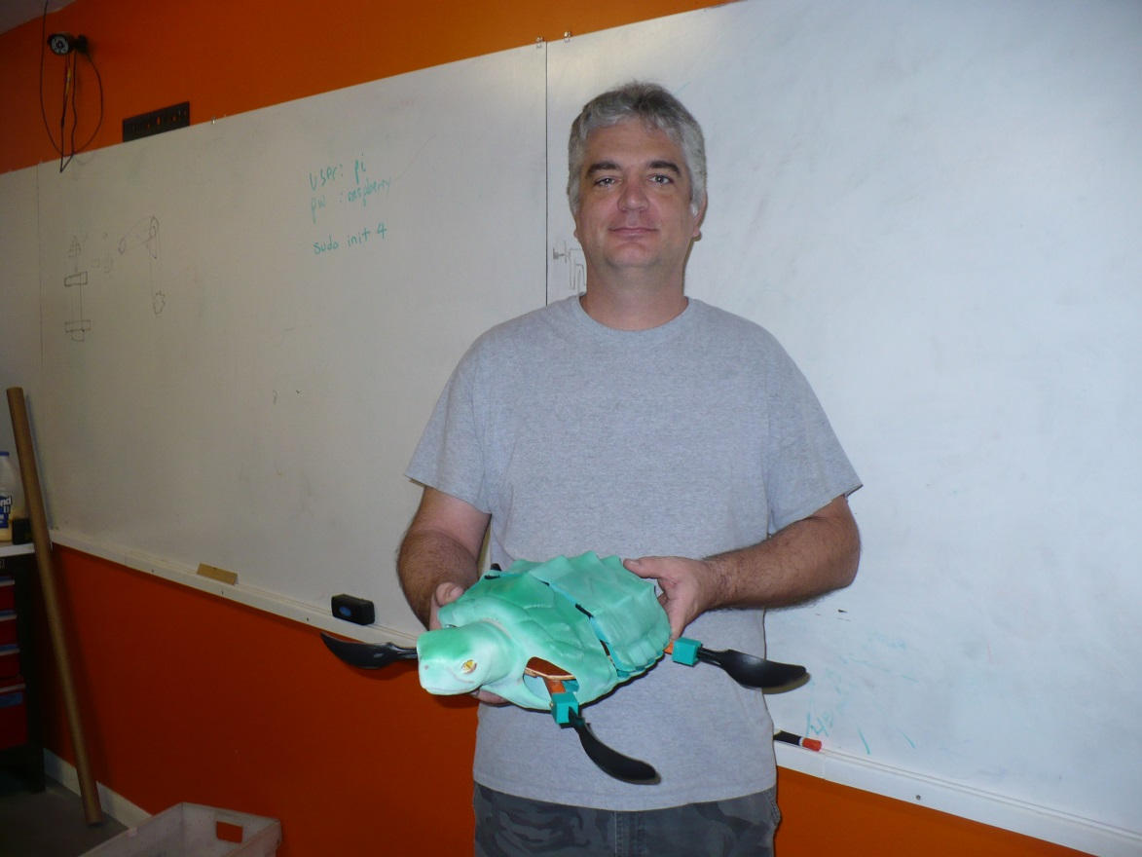
Our Solution
The Turtle AUV!

Slide 7
Control and Communications Systems Diagram
Arduino
Serial
Sonar (Future System)
Memory
Micro SD Card
I2C
IMU Fusion 9 DOF board
I2C
Barometric Pressure
Temperature
Altitude Sensor
PI
USB
Cell phone + GPS board
GPS Antenna
Serial
CELL Antenna
Sim Card
PWM
Motor Shield
PWM
Motor Controller 1
Motor 1, Front Rt Fin
PWM
Motor Controller 2
PWM
Motor 2 Front Left Fin
PWM
Motor Controller 3
PWM
Motor 3 Rear Fins

Slide 8
Power Distribution Diagram
Battery
Lithium
3.6 volts
3.6 VDC
Cell phone + GPS board
Battery
NiMh
3.6 Volt
3.6 VDC
Arduino Shield
Motor Control
3.6 VDC
Arduino
5 VDC
IMU Fusion 9 DOF board
PI
3.3 VDC
Barometric Pressure
Temperature
Altitude Sensor
Battery 9VDC
9 VDC
5 VDC
Sonar (Future System)

Slide 9
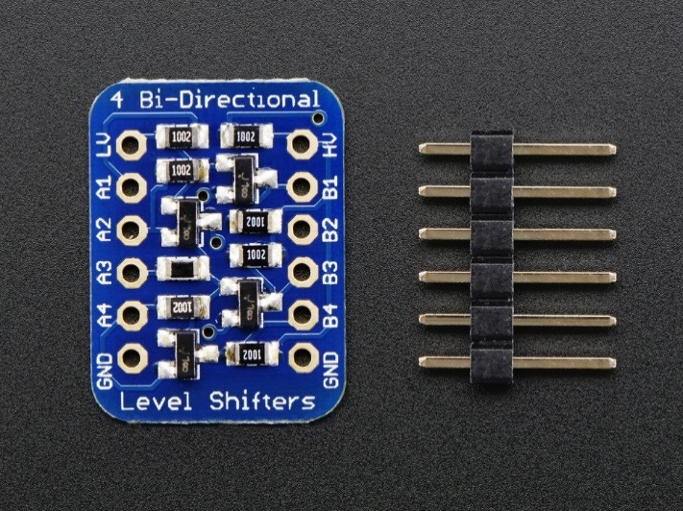
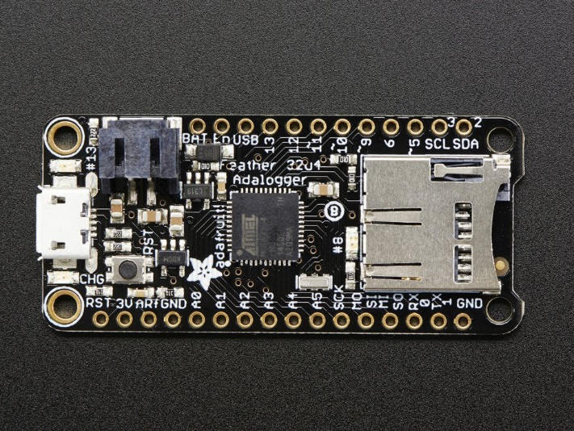
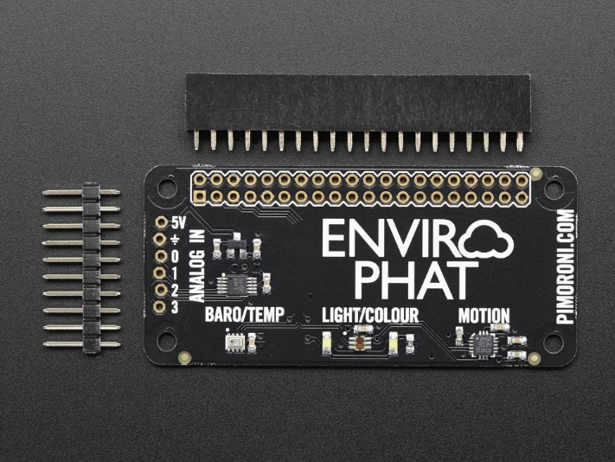
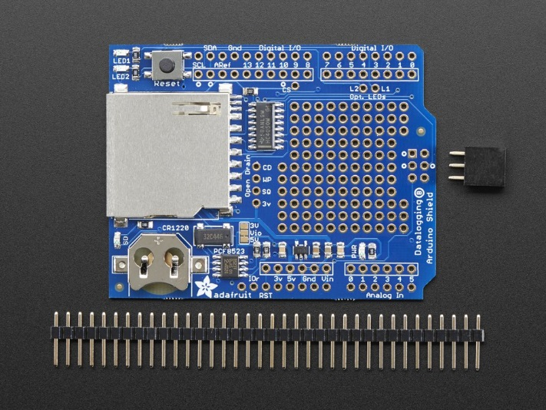
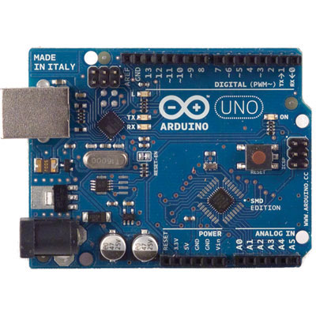
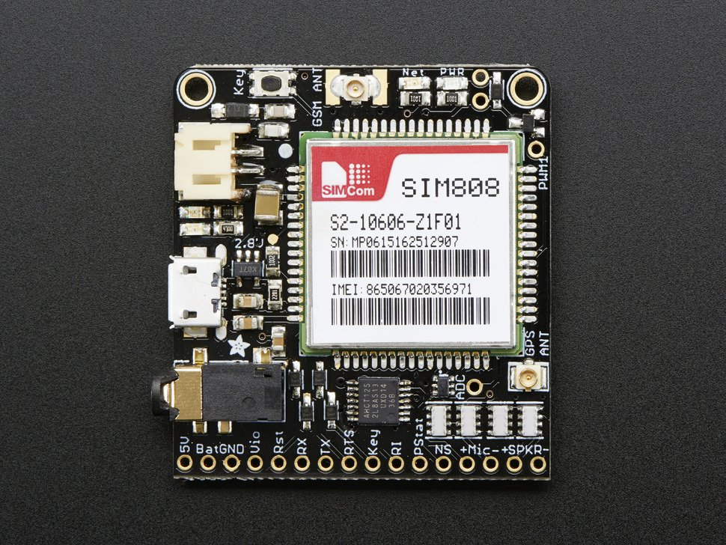
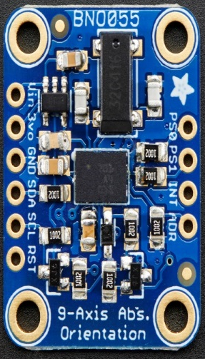

Slide 10
Mission Definition
Turtle mission is defined by a file loaded onto SD card prior to mission. File contains:
Magnetic Variation for mission area
Calm water (“no current”) swim speed
Time interval (in seconds) between surfacing for GPS position checks.
Number of waypoints (WPTs) in mission
Lat/Lon coordinates of each (WPT)
Notes:
10

Slide 11
Turtle Controller Software
Runs on Pi Zero, under Rasbpian OS
Takes initial GPS check to define “home”
Lat/Lon WPTs converted to UTM coordinates.
Conversion algorithm gives UTM coordinates accurate to within 0.01 meters north and east (!)
All navigation, current speed/direction calculations, etc. are performed with UTM coordinates.
Notes:
11

Slide 12
Turtle Controller Navigation
Navigates to WPT by:
Computing next segment of route towards WPT
ETE, ETA, course, estimated speed, estimated segment endpoint
Course is corrected for current and magnetic variation
Estimated speed derived from course and calm water speed corrected for current direction and speed.
Notes:
12

Slide 13
Turtle Controller GPS Check
Initiate GPS check at the end of route segment
When traveling for surfacing interval seconds, route segment is complete.
Surface for GPS check
When surfaced:
Get GPS location
Calculate current speed and direction by comparing actual position to segment estimated position and speed.
Notes:
13

Slide 14
Turtle Controller AI
When calculating route segment ETE, compute:
Estimated battery power remaining if route segment is traveled.
Estimated battery power required to travel from end of route segment back to mission starting point (home).
Notes:
14

Slide 15
Turtle Controller AI (con’t)
If traveling to the end of the route segment would leave insufficient power to return from that point to home:
Abort mission. Return to home.
Otherwise, travel the route segment.
Notes:
15

Slide 16
Questions?

